Slide 1
Doubly Linked List

Slide 2
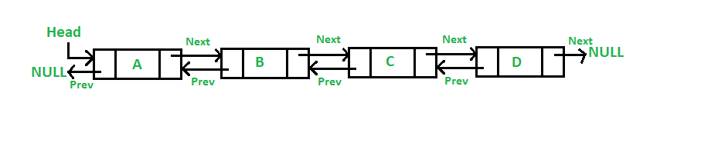
Doubly Linked List (DLL)
A Doubly Linked List (DLL) contains an extra pointer, typically called previous pointer, together with next pointer and data which are there in singly linked list.

Slide 3
Advantages
1) A DLL can be traversed in both forward and backward direction. 2) The delete operation in DLL is more efficient if pointer to the node to be deleted is given. In singly linked list, to delete a node, pointer to the previous node is needed. To get this previous node, sometimes the list is traversed. In DLL, we can get the previous node using previous pointer.

Slide 4
Disadvantages
1) Every node of DLL Require extra space for an previous pointer. It is possible to implement DLL with single pointer though . 2) All operations require an extra pointer previous to be maintained. For example, in insertion, we need to modify previous pointers together with next pointers. For example in following functions for insertions at different positions, we need 1 or 2 extra steps to set previous pointer.
Notes:
Source: https://www.geeksforgeeks.org/doubly-linked-list/

Slide 5
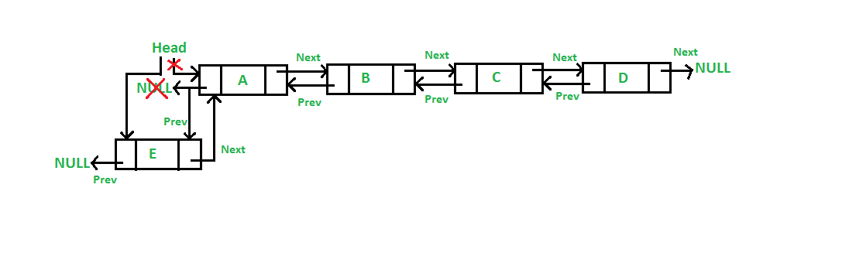
Insertion
1) Add a node at the front: (A 5 steps process)
The new node is always added before the head of the given Linked List. And newly added node becomes the new head of DLL.

Slide 6
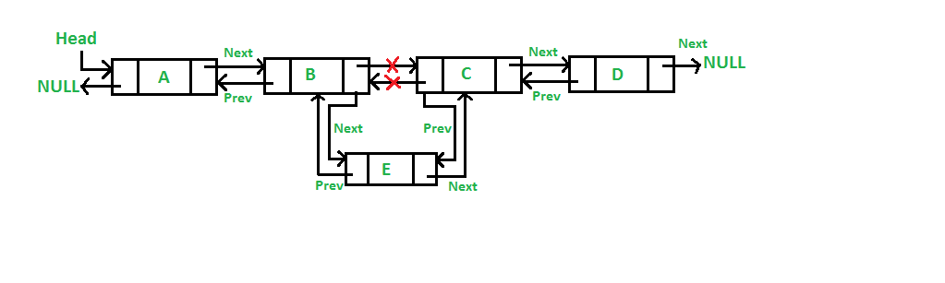
Insertion
2) Add a node after a given node.: (A 7 steps process) We are given pointer to a node as prev_node, and the new node is inserted after the given node.

Slide 7
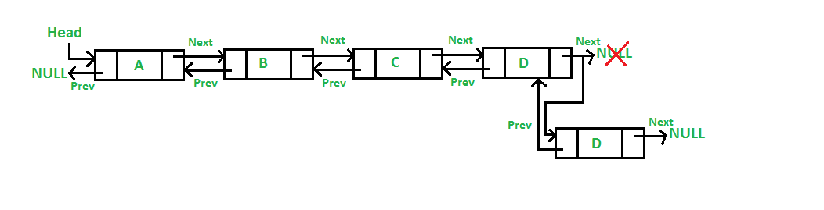
Insertion
3) Add a node at the end: (7 steps process) The new node is always added after the last node of the given Linked List.

Slide 8
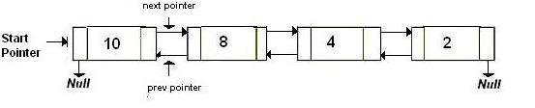
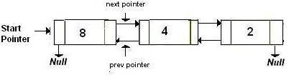
Deletion
(a) After deletion of head node

Slide 9
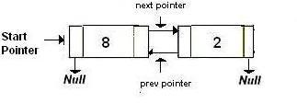
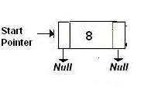
Deletion
(b) After deletion of middle node
(c) After deletion of last node

Slide 10
Algorithm Let the node to be deleted is del. 1) If node to be deleted is head node, then change the head pointer to next current head. 2) Set next of previous to del, if previous to del exists. 3) Set prev of next to del, if next to del exixts.

Slide 11
Question
WAP to reverse Doubly Linked List
Hint: swap prev and next pointers for all nodes, change prev of the head (or start) and change the head pointer in the end.
Soln: reverse_doubly.C

